Slide 1
7 Data and Analytics for IoT
Yuemin Ding
Tecnun School of Engineering
University of Navarra

Slide 2
Outlines
An Introduction to Data Analytics for IoT
Big Data Analytics Tools and Technology
Edge Streaming Analytics
Network Analytics

Slide 3
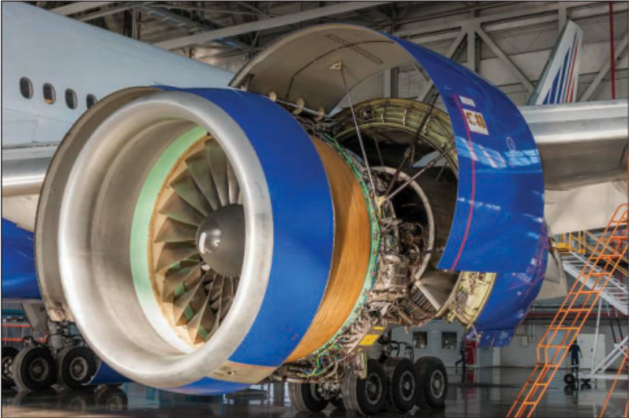
Data Analytics for IoT
In IoT, the creation of massive amounts of data from sensors is one of the biggest challenges.
Modern jet engines are fitted with thousands of sensors that generate 10GB of data per second.
A twin-engine commercial aircraft with these engines operating on average 8 hours a day will generate over 500 TB of data daily.

Slide 4
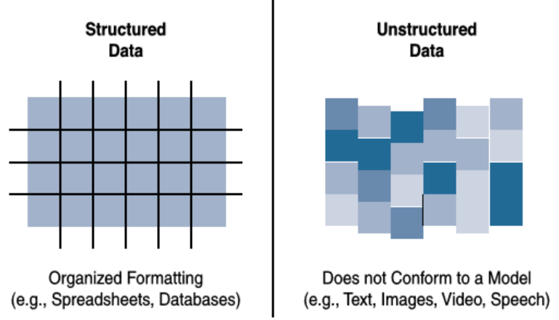
Structured v.s. Unstructured Data
Structured data means that the data follows a model or schema that defines how the data is represented or organized.
Unstructured data lacks a logical schema for understanding and decoding the data through traditional programming means.

Slide 5
Structured v.s. Unstructured Data
Structured data and unstructured data require different toolsets for analysis.
Around 80% of a business’s data is unstructured.

Slide 6
Data in Motion Versus Data at Rest
Data in IoT networks is either in transit (“data in motion”) or being held or stored (“data at rest”).
Data in motion include traditional client/server exchanges, such as web browsing and file transfers, and email.
Data saved to a hard drive, storage array, or USB drive is data at rest.
Data in motion → real-time processing and analysis → Spark, Storm, and Flink, etc.
Data at rest → huge volume → Hadoop.

Slide 7
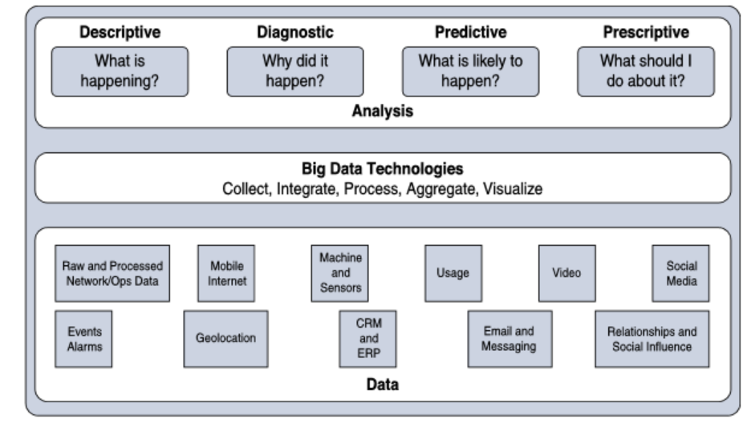
IoT Data Analytics Overview
Data analysis is typically broken down by the types of results that are produced:
Descriptive: tells what is happening, either now or in the past.

Slide 8
IoT Data Analytics Overview
Data analysis is typically broken down by the types of results that are produced:
Diagnostic: provides the answer when you are interested in the “why”.

Slide 9
IoT Data Analytics Overview
Data analysis is typically broken down by the types of results that are produced:
Predictive: foretells problems or issues before they occur

Slide 10
IoT Data Analytics Overview
Data analysis is typically broken down by the types of results that are produced:
Prescriptive: recommends solutions for upcoming problems.

Slide 11
Outlines
An Introduction to Data Analytics for IoT
Big Data Analytics Tools and Technology
Edge Streaming Analytics
Network Analytics

Slide 12
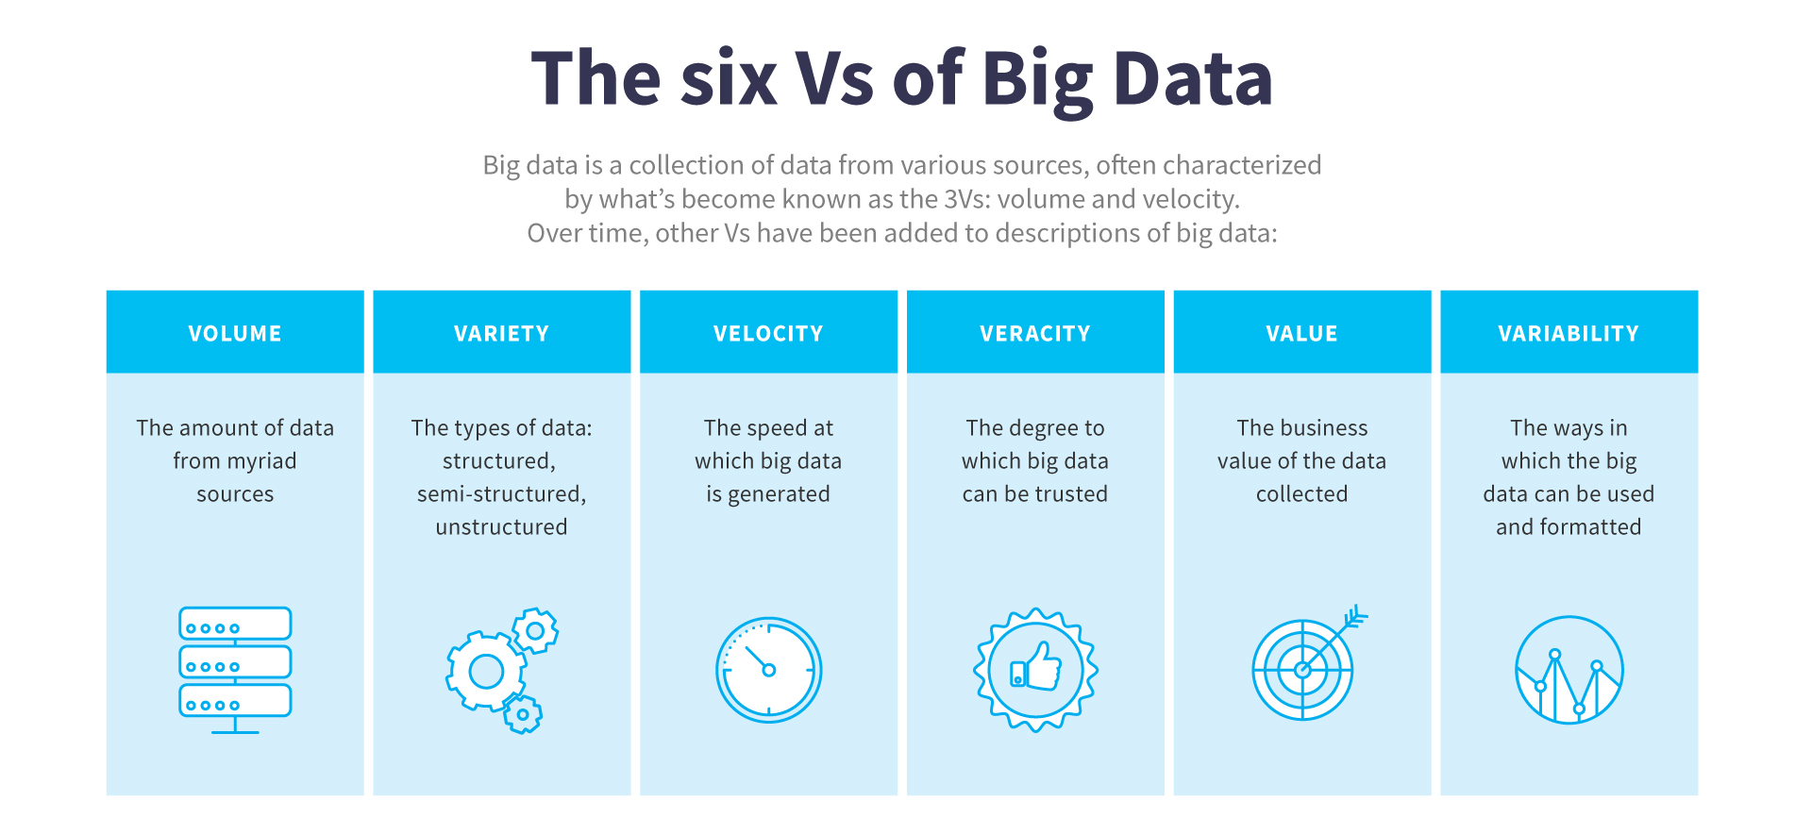
Big Data Analytics Tools and Technology
‘Three Vs’ to categorize big data:
Velocity refers to how quickly data is being collected and analyzed.
Variety refers to different types of data.
Volume refers to the scale of the data.
Over time, other Vs have been added to big data

Slide 13
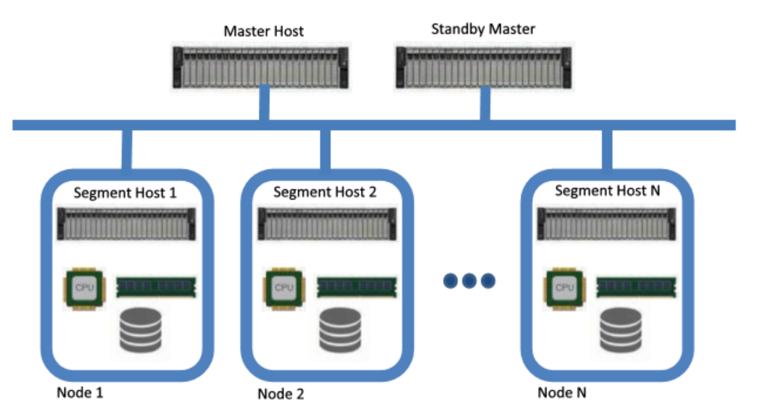
Massively Parallel Processing Databases
Massively parallel processing (MPP) databases were built on the concept of the relational data warehouses
MPP are designed to be much faster, to be efficient, and to support reduced query times.

Slide 14

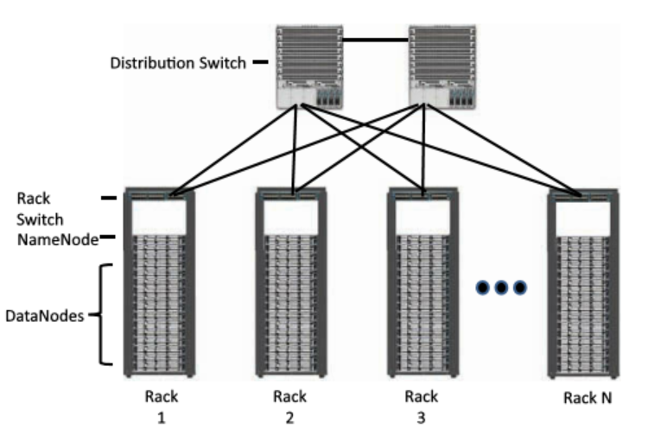
Hadoop
Hadoop was originally developed as a result of projects at Google and Yahoo!
The project had two key elements:
Hadoop Distributed File System (HDFS): A system for storing data across multiple nodes
MapReduce: A distributed processing engine that splits a large task into smaller ones that can be run in parallel

Slide 15
Hadoop
Hadoop takes advantage of a distributed architecture to store and process massive amounts of data and can leverage resources from all nodes in the cluster.

Slide 16
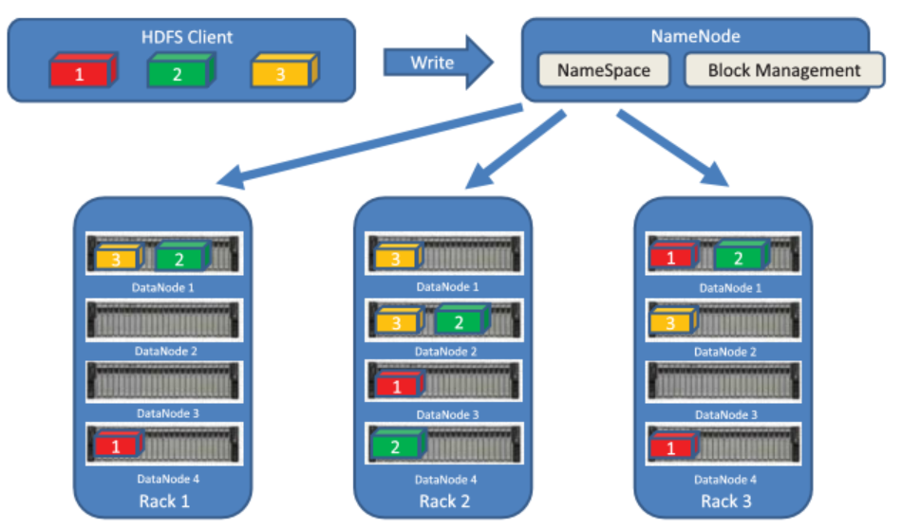
Hadoop
NameNodes: They coordinate where the data is stored and maintain a map of where each block of data is stored and where it is replicated.
DataNodes: These are the servers where the data are stored.

Slide 17
Hadoop
Drawback:
MapReduce breaks down a query into smaller tasks, which is useful for the analysis of historical data.
Depending on how much data is being queried and the complexity of the query, the result could take seconds or minutes to return.
If you have a real-time process running, MapReduce is not the right data processing engine for that.

Slide 18

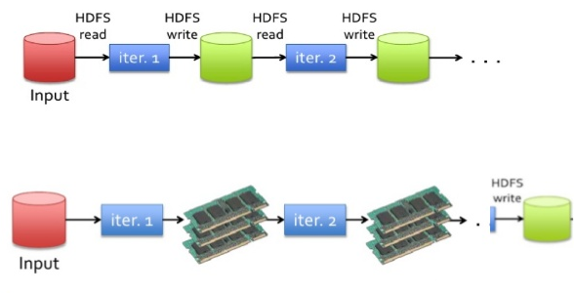
Apache Spark
Apache Spark is an in-memory distributed data analytics platform designed to accelerate processes in the Hadoop ecosystem.
At each stage of a MapReduce operation, the data is read and written back to the disk → latency and slow
With Spark, the processing of this data is moved into high-speed memory → allowing near-real-time processing of events
Hadoop
Spark
Source: analyticsvidhya.com

Slide 19
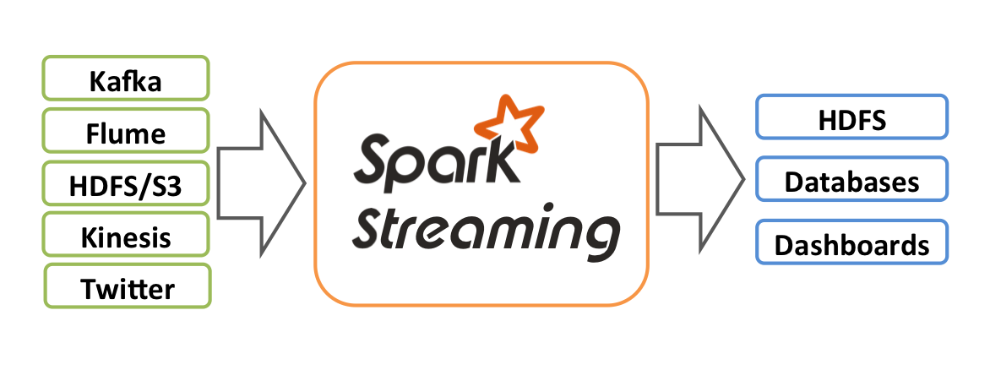
Apache Spark
Real-time processing is done by a component of the Apache Spark project called Spark Streaming.
Spark Streaming is responsible for taking live-streamed data from a messaging system and dividing it into smaller micro-batches.
The Spark processing engine operates on these smaller pieces of data, allowing rapid insights into the data and subsequent actions.
Similar platforms include Apache Storm and Flink.
Source: analyticsvidhya.com

Slide 20

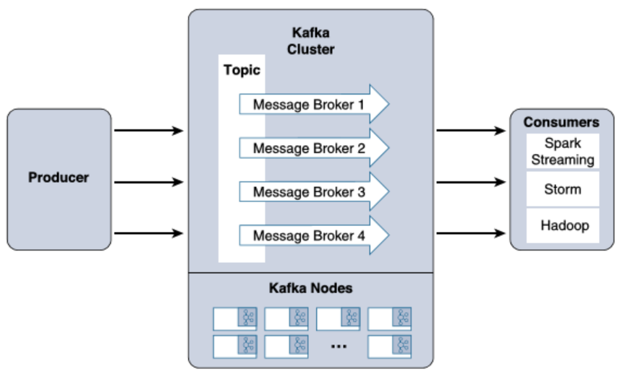
Apache Kafka
Apache Kafka is a messaging system is designed to accept data, or messages, from where the data is generated and delivered the data to stream-processing engines such as Spark Streaming or Storm.

Slide 21
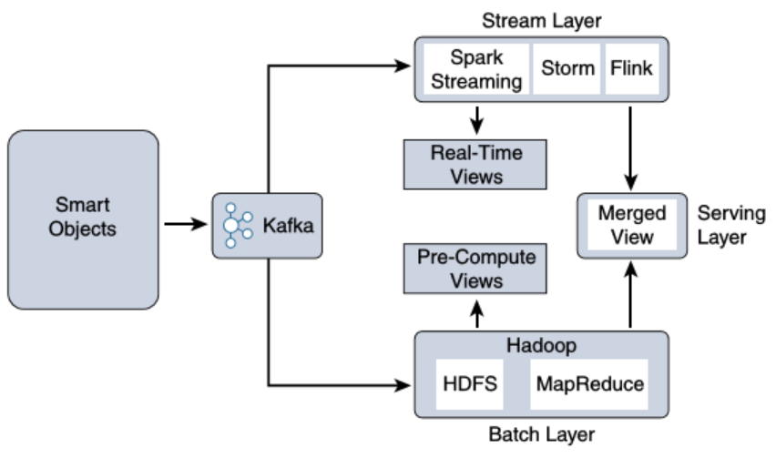
Lambda Architecture
Ultimately, the key elements of IoT use cases involve the collection, processing, and storage of data using multiple technologies.
Querying both data in motion (streaming) and data at rest (batch processing) requires a combination of different projects.

Slide 22
Outlines
An Introduction to Data Analytics for IoT
Big Data Analytics Tools and Technology
Edge Streaming Analytics
Network Analytics

Slide 23
Edge Streaming Analytics
Key values of edge streaming analytics
Reducing data at the edge → Passing all the IoT data to the cloud is inefficient and is expensive in terms of bandwidth and network infrastructure
Analysis and response at the edge → Some data is useful only at the edge (such as the control within a local factory)
Time sensitivity → Edge analytics allows timely analysis and immediate responses to changing conditions

Slide 24
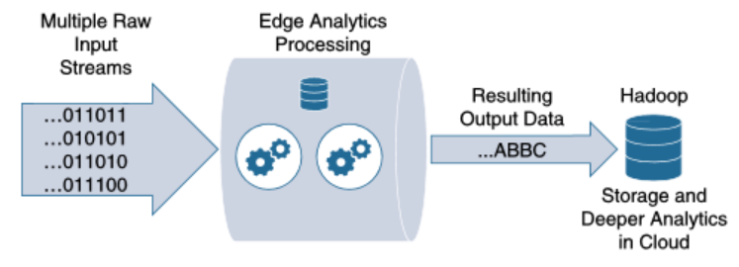
Edge Streaming Analytics
Three stages of streaming analytics at the edge:
Raw input data → data coming from the sensors into the analytics processing unit
Analytics processing unit (APU) → filters and combines data streams, organizes them by time windows, and performs various analytical functions
Output streams → The data that is organized into insightful streams and passed on for storage and further processing in the cloud.

Slide 25
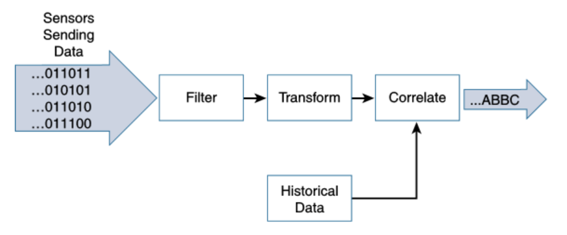
Edge Streaming Analytics
Core functions of the Analytics Processing Unit (APU):
Filter → identifies the information that is considered important to be processed on the edge
Transform → manipulate the data structure into a form required for further processing
Time → establish a timing context of real-time streaming data flows

Slide 26
Edge Streaming Analytics
Core functions of the Analytics Processing Unit (APU):
Correlate → combine multiple data streams from different types of sensors, such as body temperature, heart rate, and blood pressure of the patient
Match patterns → gain deeper insights into the data, such as a sudden change in heart rate
Improve business intelligence → more quickly and timely response

Slide 27
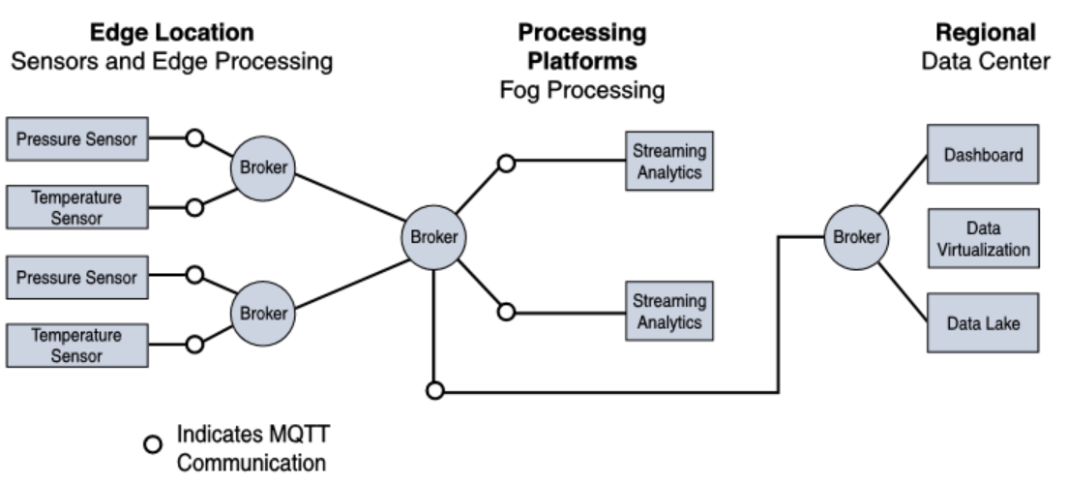
Edge Streaming Analytics
Depending on the application, analytics can happen at any point throughout the IoT system
An example of pressure and temperature measurement on an oil rig:
Analytics directly on the edge
Fog node locating on the same oil rig performs streaming analytics from several edge devices
After fog analysis, result forwarded to the cloud for deeper historical analysis

Slide 28
Outlines
An Introduction to Data Analytics for IoT
Big Data Analytics Tools and Technology
Edge Streaming Analytics
Network Analytics

Slide 29
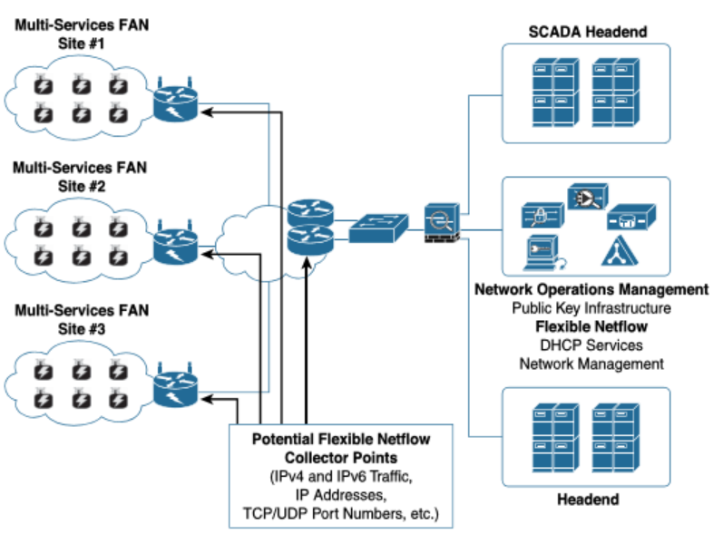
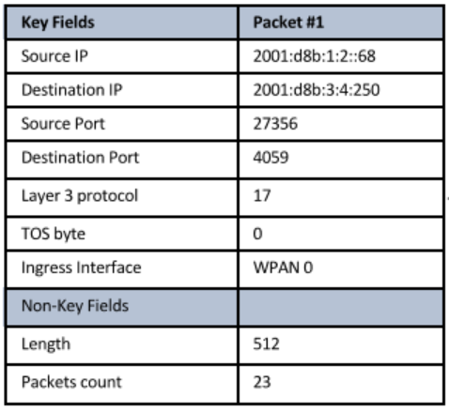
Network Analytics
Data analytics → finding patterns in the data generated by endpoints
Network analytics → discovering patterns in the communication flows from a network perspective

Slide 30
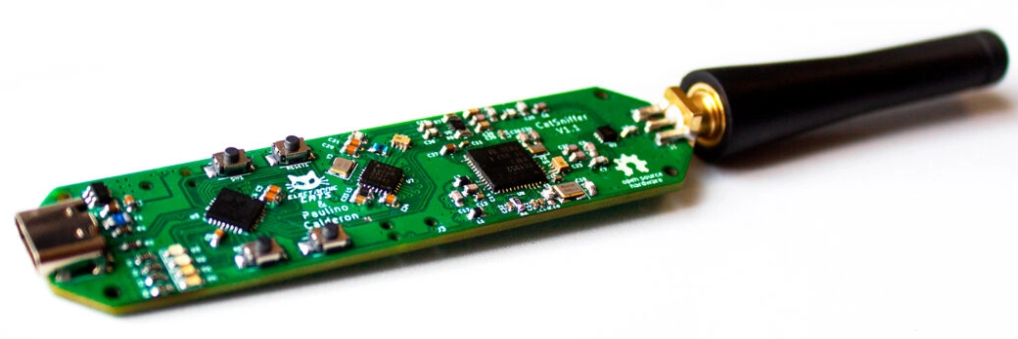
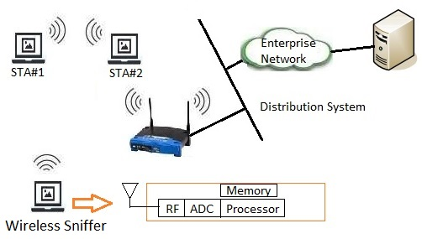
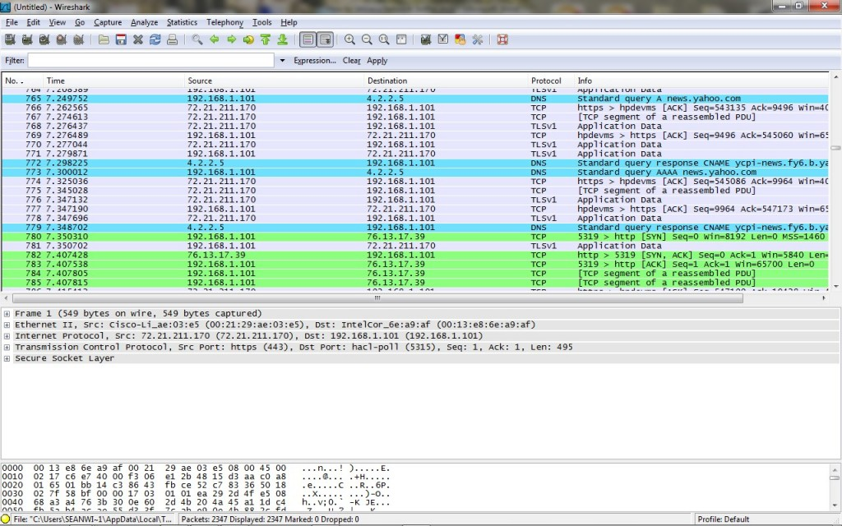
Network Analytics
For wireless IoT networks, packet sniffer can be used for flow analytics
CatSniffer
Wireshark
Source: test-and-measurement-world.com

Slide 31
Network Analytics
The benefits of network flow analytics:
Network traffic monitoring and profiling→ IPv4/IPv6 networkwide traffic volume and pattern analysis
Application traffic monitoring and profiling → gain a detailed time-based view of IoT access services, such as MQTT and CoAP
Capacity planning → track and anticipate IoT traffic growth and help in the planning of upgrades
Security analysis→ change in network traffic behavior may indicate a cyber security event, such as a denial of service (DoS) attack.
Accounting → analyze and optimize the billing
Data warehousing and data mining → Flow data can be warehoused for later retrieval and analysis

Slide 32
Summary
An Introduction to Data Analytics for IoT
Big Data Analytics Tools and Technology
Edge Streaming Analytics
Network Analytics

Slide 33
Thank you!
Q&A

